Slide 1

Capstone 1: E-commerce website
By: Waleed Mohammed Althubyani

Slide 2
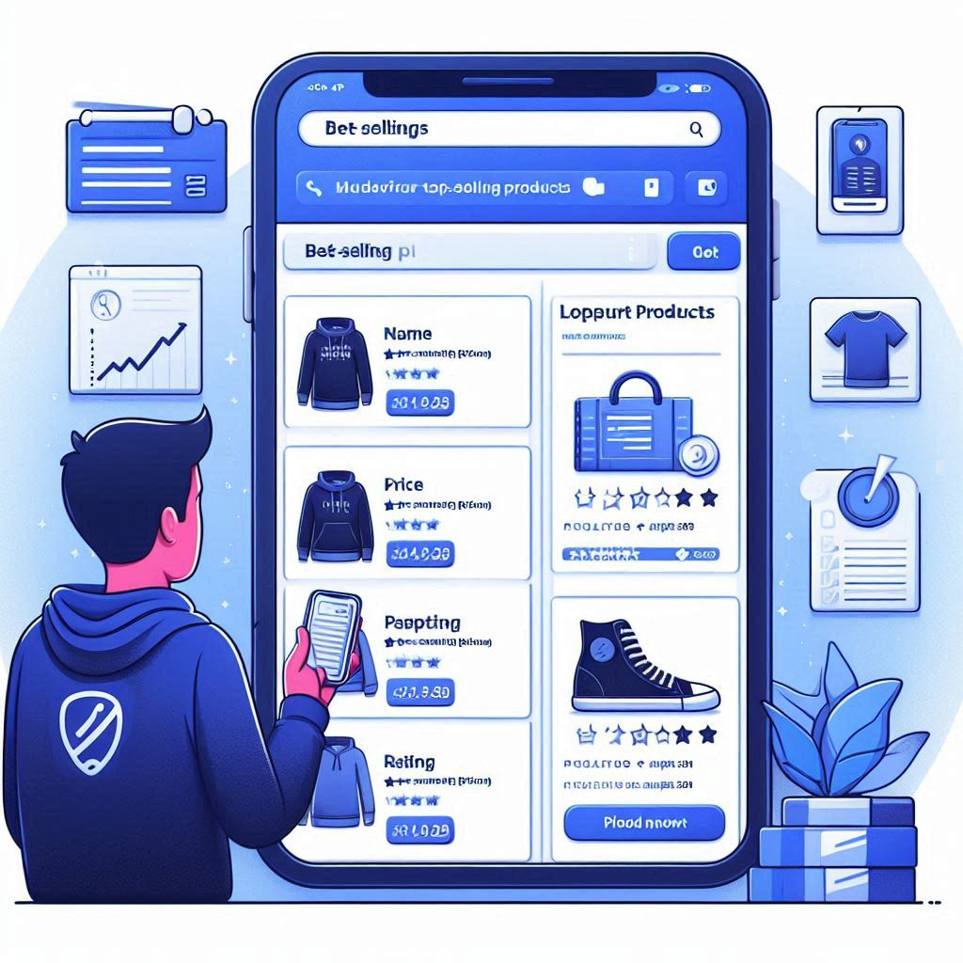
Best Selling Products
Limit

Slide 3

Review a product
Customer
Product
Purchased
Review

Slide 4
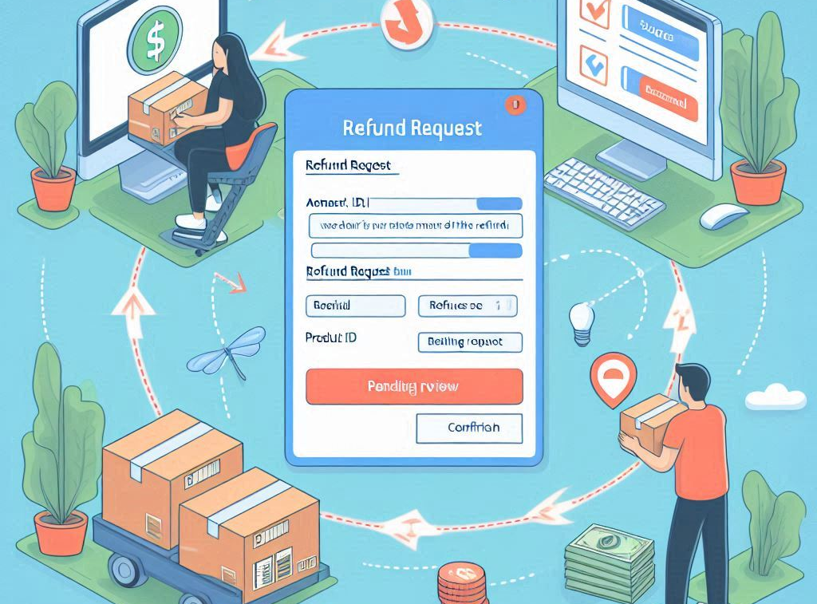
Request Refund
Customer
Product
Reason

Slide 5

Decide on Refund
Admin
Customer
Product
Decision

Slide 6
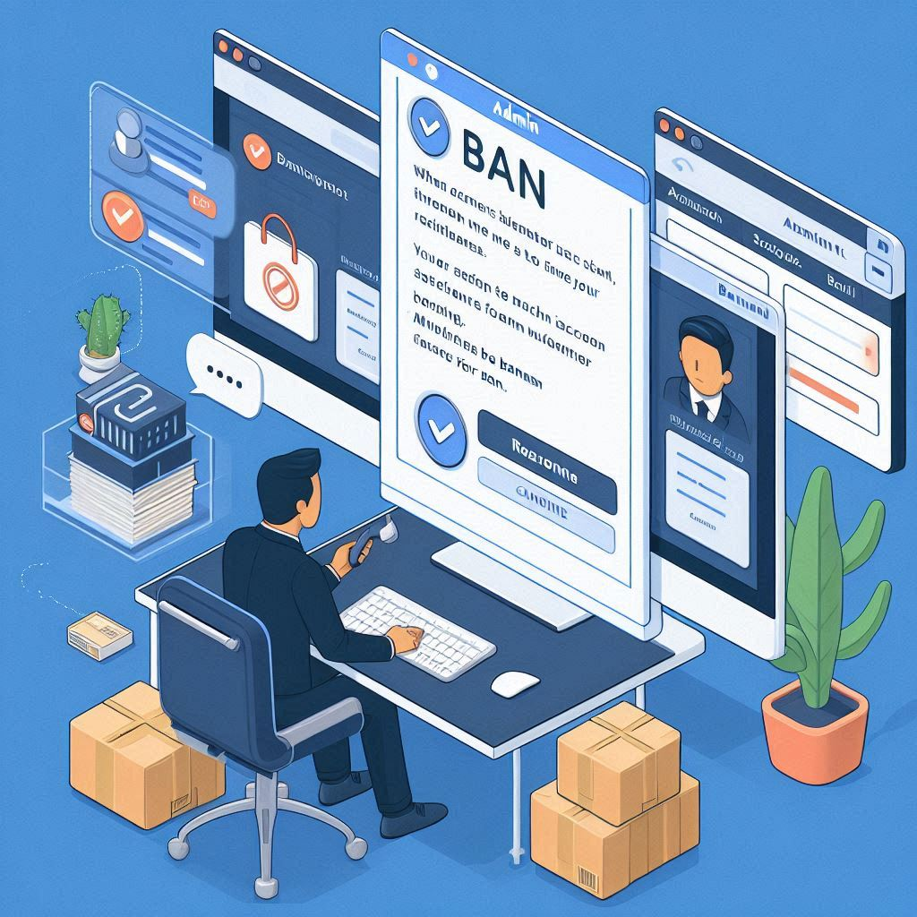
Ban Merchant
Admin
Merchant
Reason

Slide 7

Thank you for listening

